Slide 1
The pie and the Daunaut
The pie and the Daunaut

Slide 2
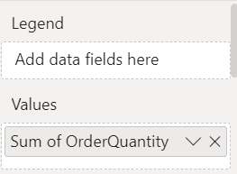
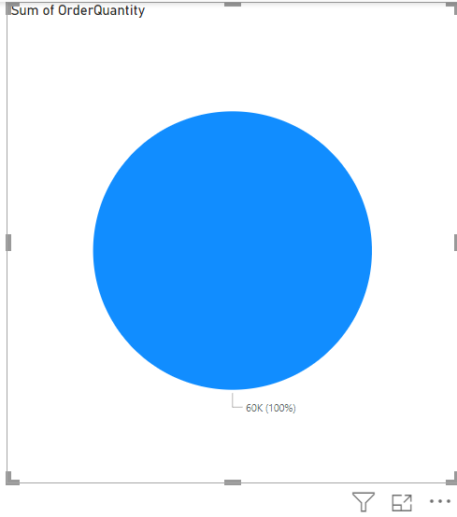
The pie and the Daunaut
Pie visualization to the scene, then add OrderQuantity from FactInternetSales to the values

Slide 3
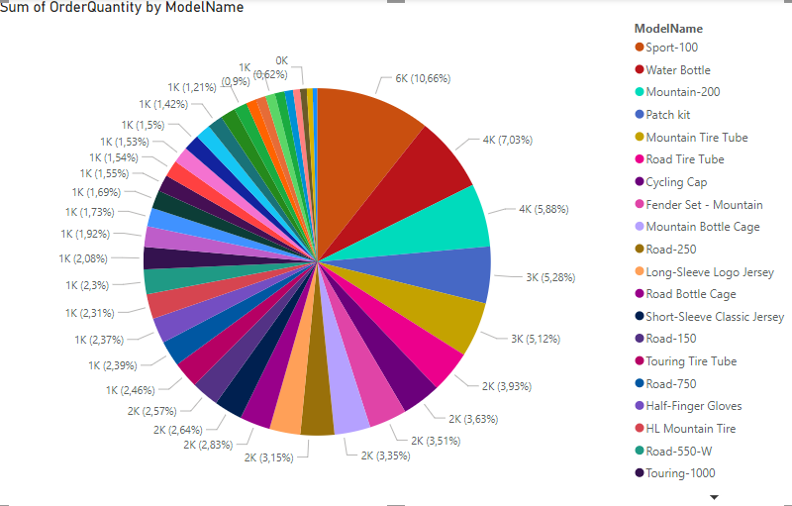
The pie and the Daunaut
Then add the model name Since DimProduct at

Slide 4
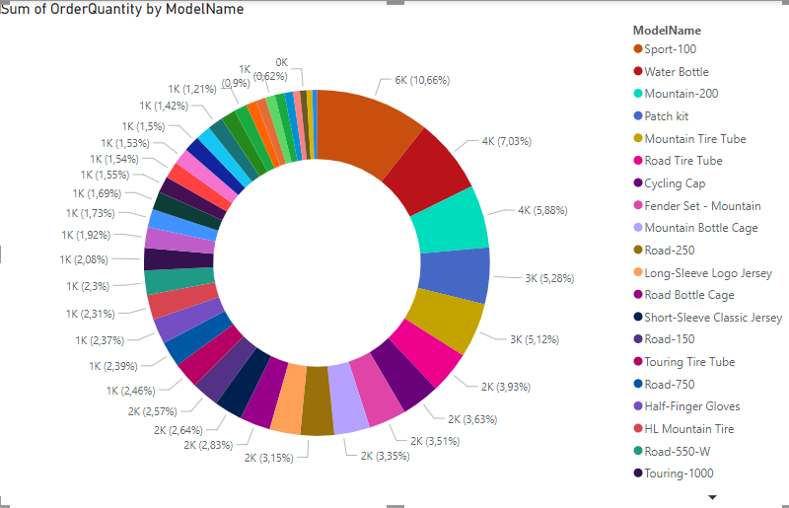
The pie and the Daunaut
Select Daunaut instead of pie

Slide 5
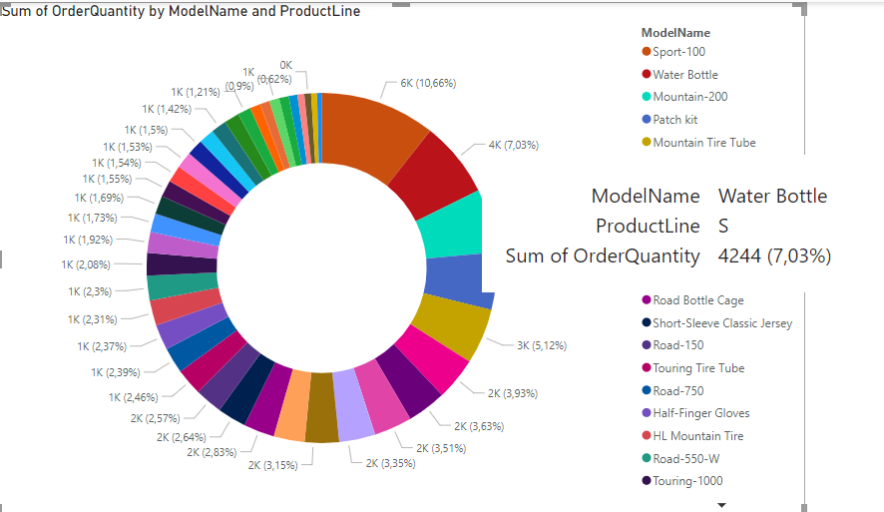
The pie and the Daunaut
Add a product line from DimProduct painting in the Details field and hover over a given segment

Slide 6
Thank you
Thank you

